Slide 1

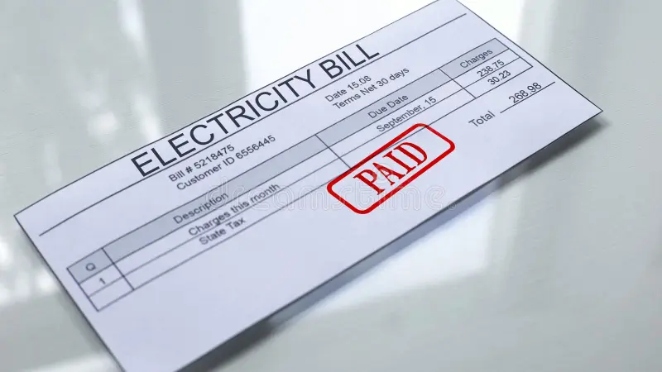
ELECTRICITY BILL MANAGEMENT SYSTEM

Slide 2


GROUP MEMBERS
Najmul Arifeen
FA24-BSE-102
Muhammad Hasnat
FA24-BSE-081

Slide 3
ELECTRICITY BILL MANAGEMENT SYSTEM
Problem
- Manual billing processes are time-consuming and error-prone.
- Difficulty in tracking payments and usage history.
- Mismanagement of customer records leads to inefficiency.
- Delays in bill generation and reporting reduce customer satisfaction.
Solution
- Automates bill generation, storage, and retrieval.
- Ensures accurate calculations and timely reporting.
- Tracks payments and usage efficiently.
- Reduces manual workload and improves operational efficiency.

Slide 4
SOFTWARE FEATURES
- Current reading of Units
- Peak and Non-Peak Hour Calculation
- Payment details ( Paid - Unpaid)
- Billing History
- Adjustable Settings
- Update Customer Details
- Update Units Consumed
- Applying Late Fee
- Monthly Summary
- Annual Summary

Slide 5
PROJECT SCOPE
Generate Bill
- Enter customer details and units consumed.
- Generate a unique Bill ID.
- Save bill details to a file.
Search Bill
- Retrieve and display bill details using the Bill ID.
Update Payment Status
- Update the payment status for a customer's bill.
Display Usage History
- Show a customer’s usage history based on their CNIC.
Apply Late Fee
- Automatically apply late fees for unpaid bills.
View Summary
- Provide a monthly or overall summary based on user selection.
Adjustable Settings
-User can change the unit price and condition on units etc.
Update Customer Details
-Details of customer are updated
Update Units Consumed
-Consumed units are changed

Slide 6
FLOW CHART
MAIN MENU
CHOOSE AN OPTION
Option==Generate Bill
Enter Customer Details
Option==Search Bill
Enter Units Consumed
Enter Bill ID
Option==Display Usage History
Generate Bill ID
Load Bill From File
Enter CNIC#
Option==Apply Late Fees
Display Bill
Check Bill Status
Option==Summary
Save Bill Details to File
Show Usage History
Update Payment Status
Summary Type
Apply Late Fees
Mark as Paid
Choose=Monthly Summary
Monthly Summary
Overall Summary
MAIN MENU
MAIN MENU

Slide 7
Option==Adjustable Settings
Change Unit Price
Update Customer Details
Update Units Consumed
Update Customer Details
Update Units Consumed
MAIN MENU
MAIN MENU

Slide 8
FUCTIONS TO BE USED
mainmenu ()
GenerateBill()
- CustomerDetails()
- UnitsConsumed()
- Taxes()
- GenerateBillID ()
SearchBill ()
- DisplayUsageHistory()
- BillStatusUpdate()
ApplyLateFee ()
Summary()
- Monthly()
- Annual()
AdjustSetting()
UpdateCustomerDetails()
UpdateUnitsConsumed ()

Slide 9
Conclusion
Automates billing, payments, and reporting
Built in C++ for efficiency
Reduces effort and improves accuracy
Scalable for future needs
Enhances operations and customer satisfaction

